Slide 1
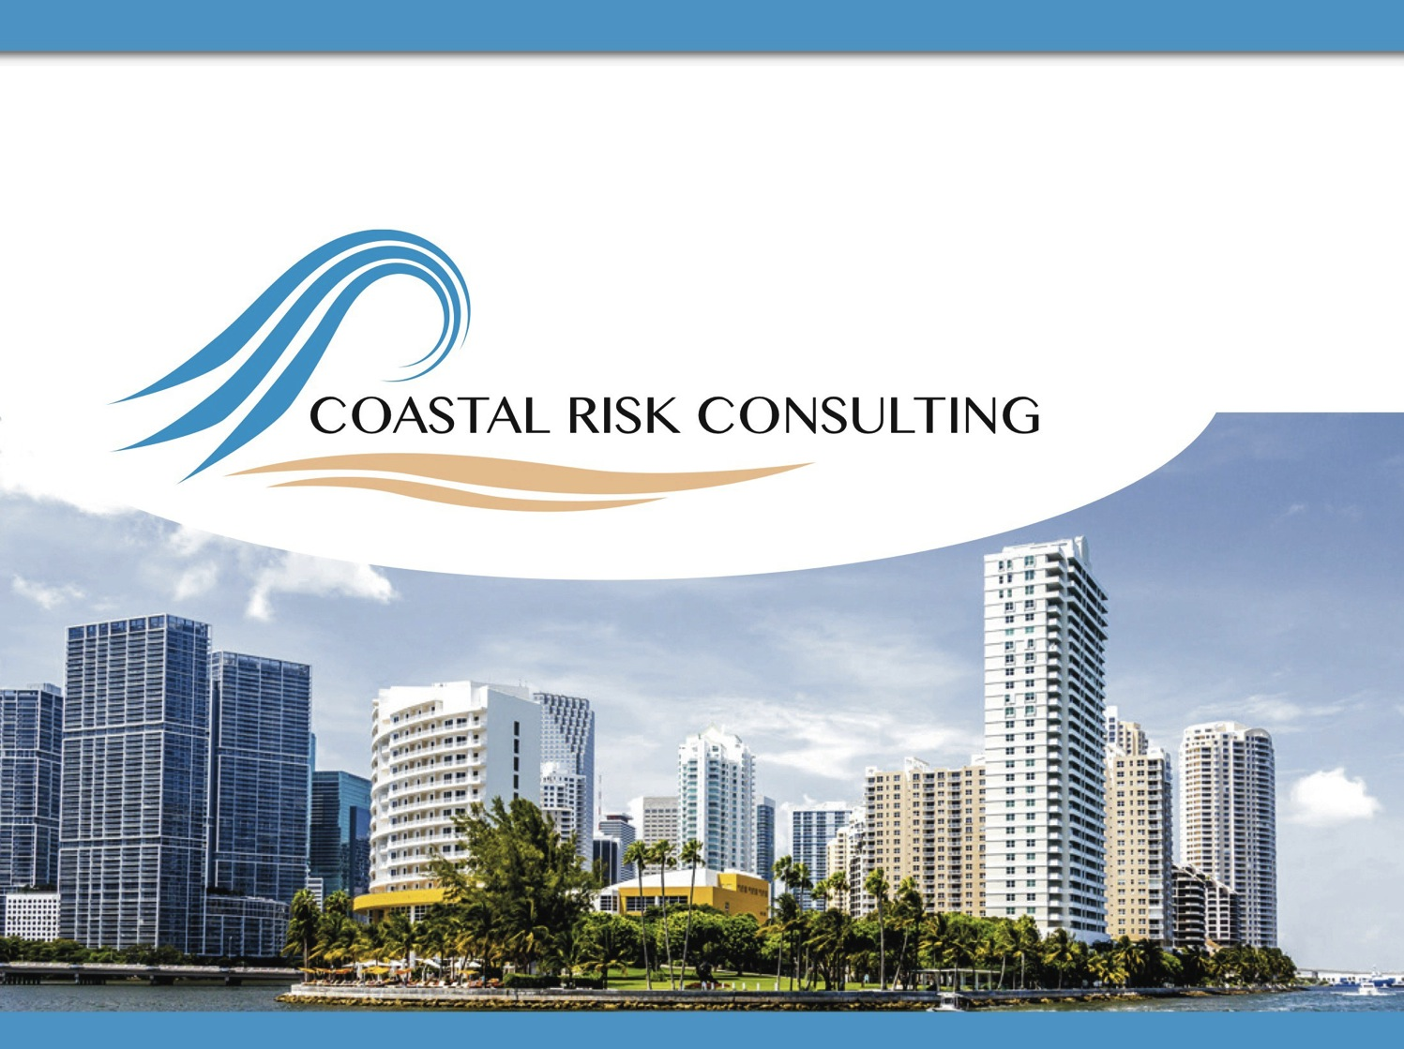
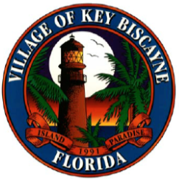
Village of Key Biscayne:
Climate Vulnerability Assessment and Adaption Strategies
February 16, 2017
1
1

Slide 2
Objectives
Provide credible and actionable information on the vulnerability of the Village of Key Biscayne to sea level rise.
Outline adaption strategies to address impacts of sea level rise.
  What are the current risks?
  How will these risks change as sea level rises?
  How do hypothetical adaptation scenarios lessen impacts?

Slide 3
Effective Adaptation Planning
Based on models developed for other cities (Boston, Miami Beach, etc.).
Four key components:
  Community Engagement
  Policy Review
  Green Adaptation Options
  Infrastructure Improvement

Slide 4
Effective Adaptation Planning
Based on models developed for other cities (Boston, Miami Beach, etc.).
Four key components:
  Community Engagement
  Policy Review
  Green Adaptation Options
  Infrastructure Improvement
      Storm Drainage Improvements
      Raising Sea Walls
      Raising Roads / Property

Slide 5
Community Engagement
Examples:
Climate Education Program for Residents / Businesses
Citizen Science Volunteer Program
Resiliency Audit Program for Property Owners

Slide 6
Policy Review
Examples:
Freeboard Ordinances
Raising of seawalls
Eliminate below-grade parking
Finance programs

Slide 7
"Green" Adaptations
Examples:
Beach Renourishment
Mangrove Restoration
"Green" Roofing
Permeable roadways

Slide 8
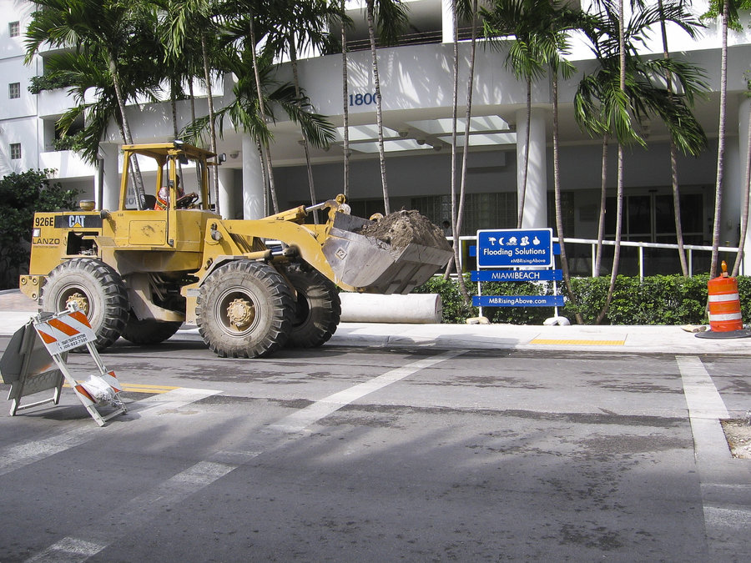
Infrastructure Improvements
Examples:
Storm Drainage Improvements
Raising Sea Walls
Raising Roads / Property
Pumping Systems

Slide 9
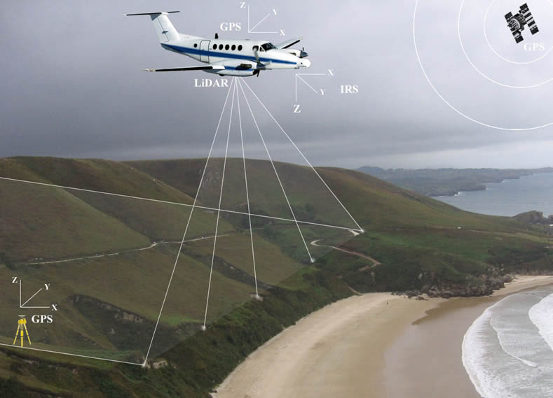
State of the Art Flood Modeling
High resolution lidar topography
Local tidal records
Projections of sea level rise

Slide 10
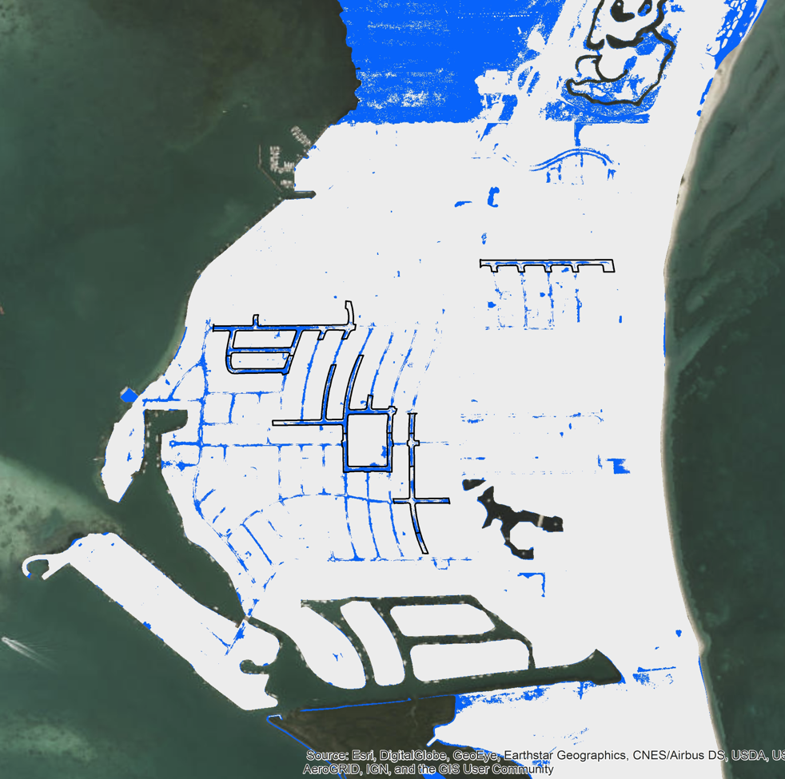
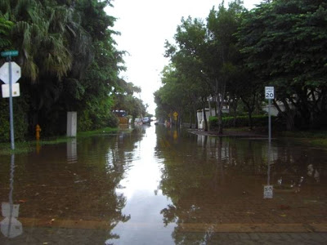
King Tide Flooding Today
CRC Model Predictions and VKB Reports
Reported
Floodwater
Hotspots

Slide 11
What’s the Problem?

Slide 12
What’s the Problem?
Drainage Under King Tide

Slide 13

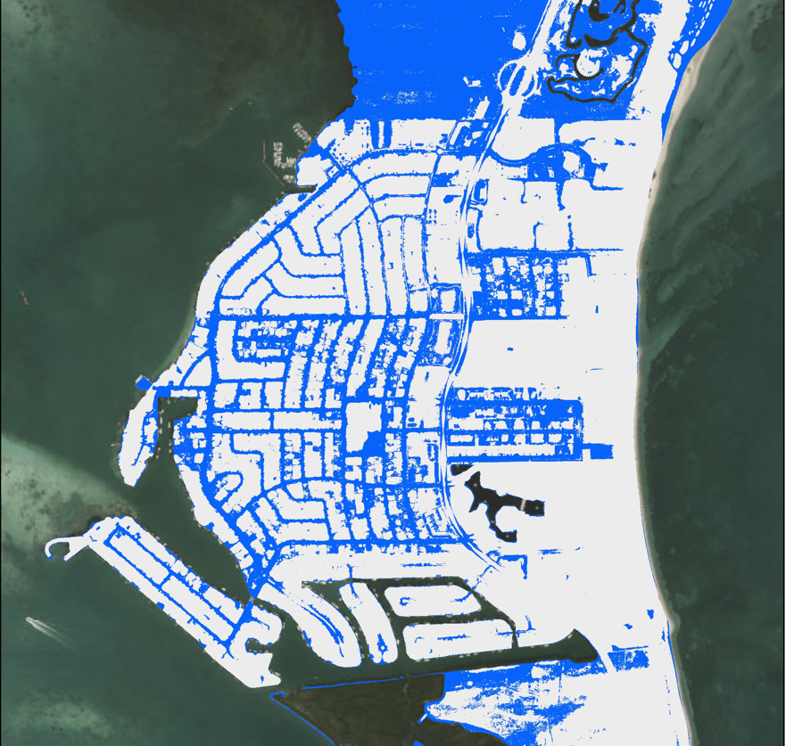
King Tide Flooding Today
King Tide Flooding 2045
No Adaptation
No Adaptation

Slide 14
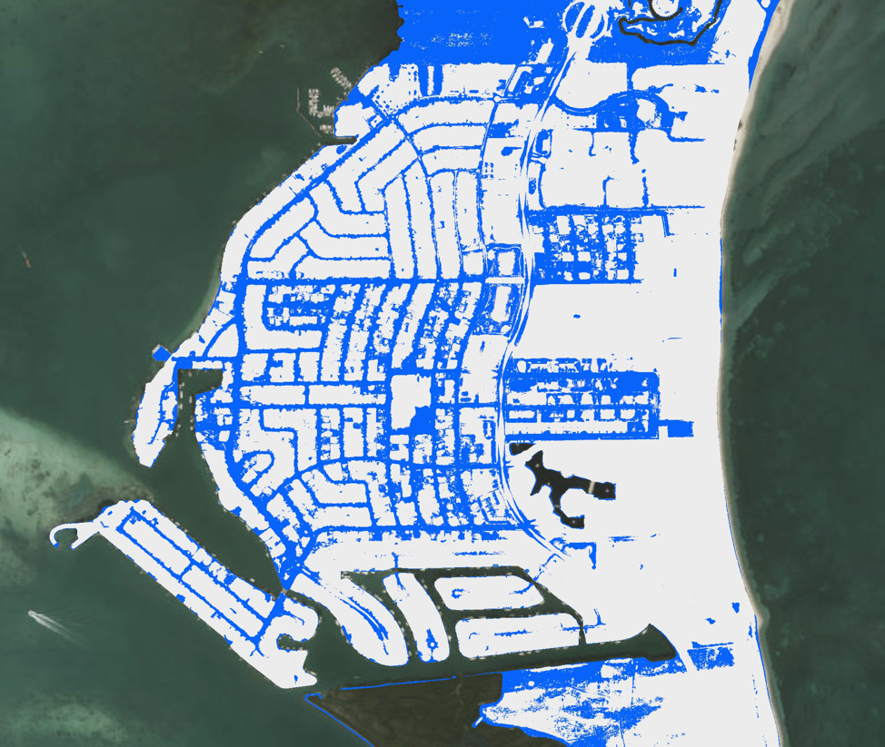
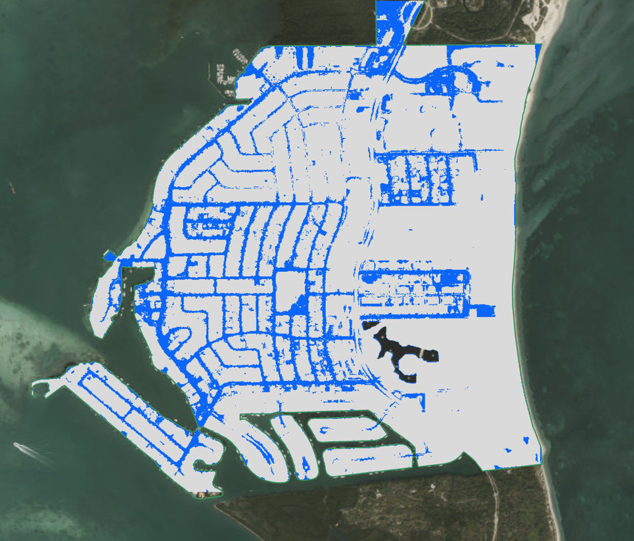
2045: No Adaptation
2045: Seawall and Storm Drain Improvements

Slide 15
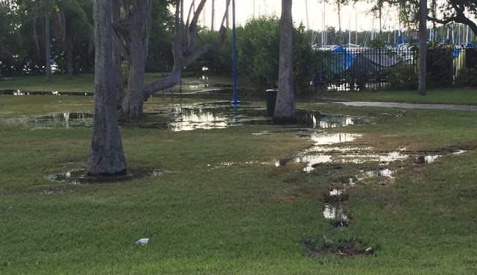
Rising Sea Level Elevates The Water Table Underground
Perimeter defenses are insufficient due to highly porous bedrock

Slide 16
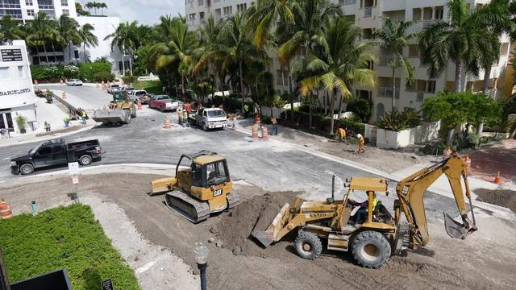
Roadway Elevation
Roads are lowest and most vulnerable to flooding
Integrated with storm drainage
Important for emergency response

Slide 17
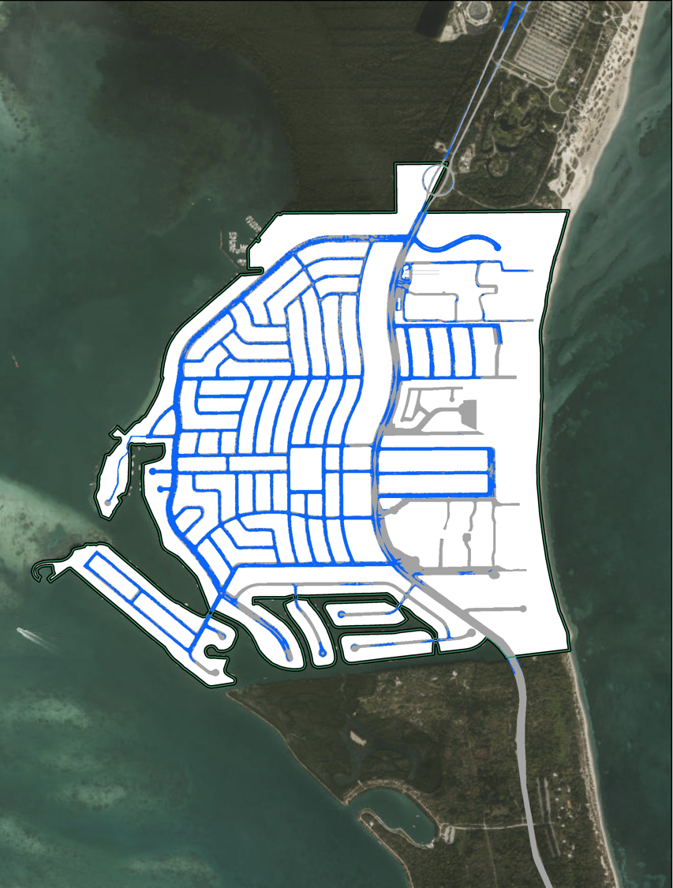
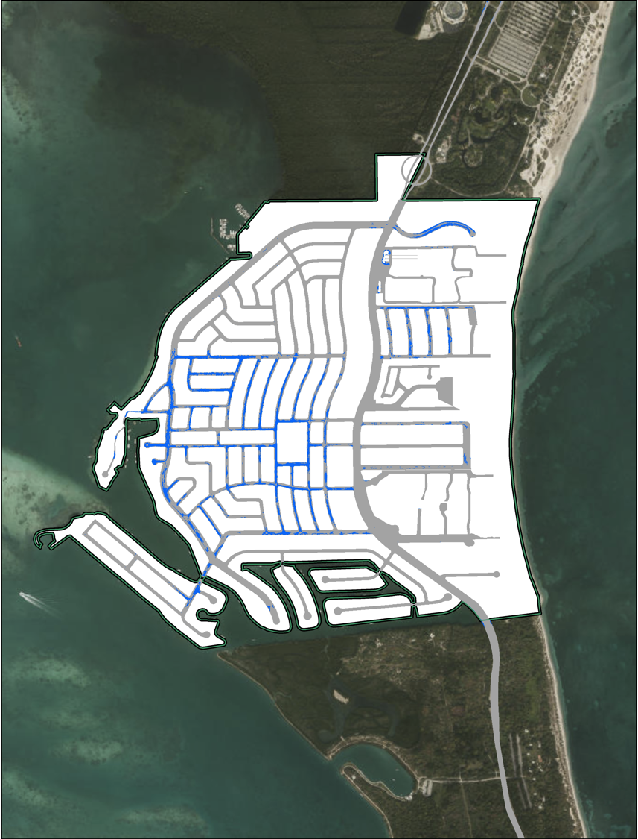
Road Flooding 2045: No Adaption
Road Flooding 2045: +1 foot elevation

Slide 18
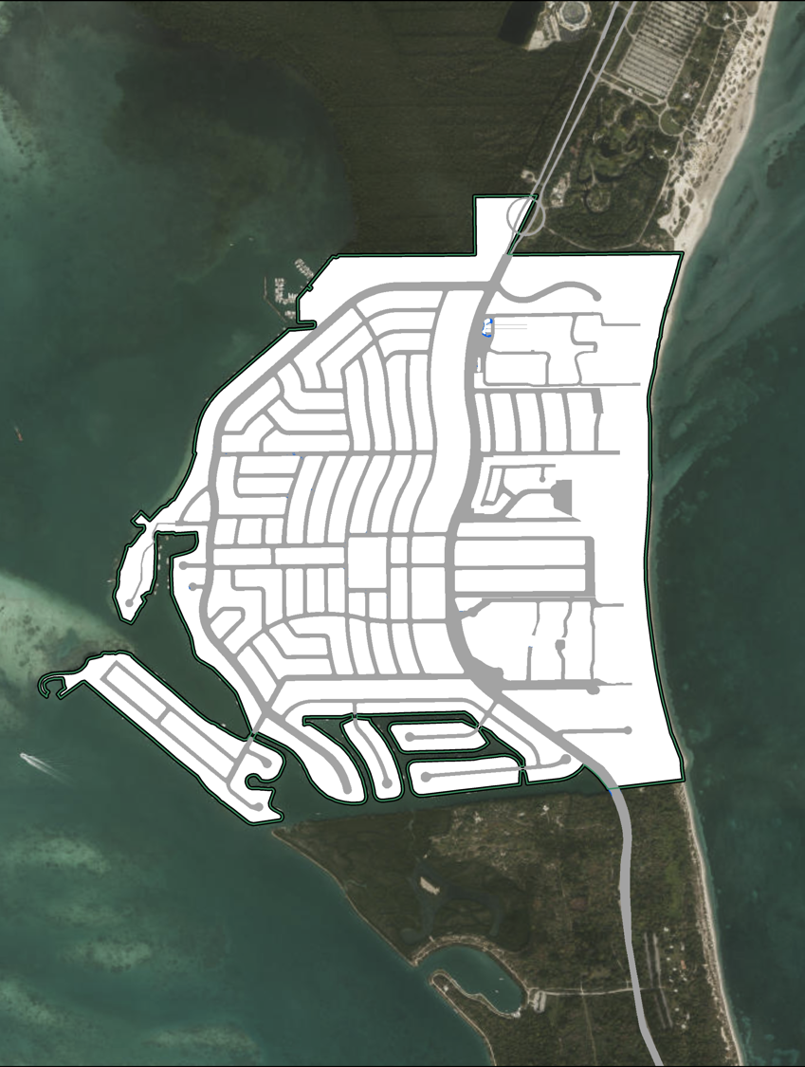
Road Flooding 2045: No Adaption
Road Flooding 2045: +2 foot elevation

Slide 19
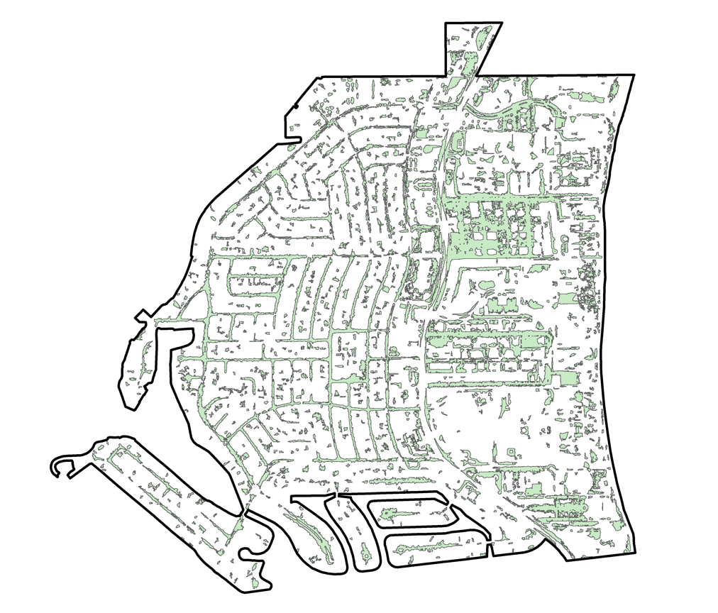
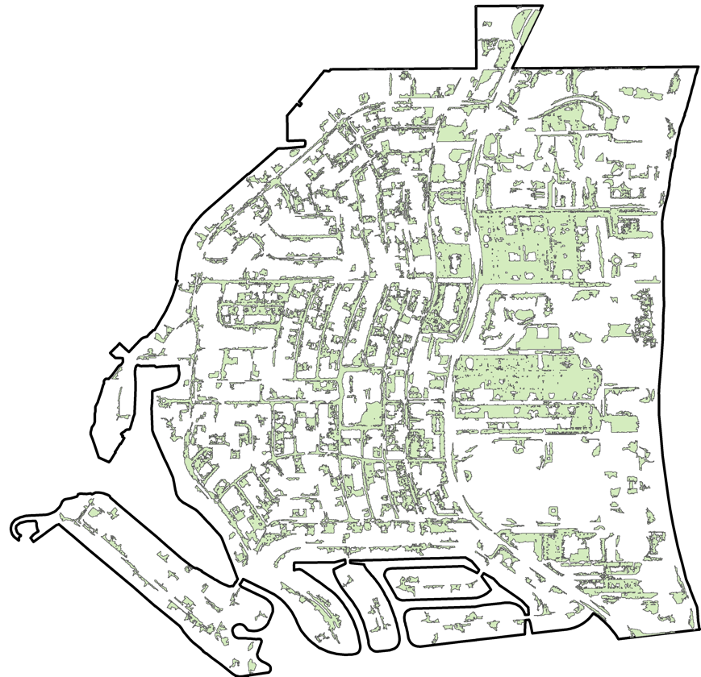
Areas of Rainfall Run-off Accumulation
Today
With Elevated Roads
Elevated roads alone will shift run-off from roadways to properties
Requires coordinated implementation with property owners and other adaption/infrastructure improvements

Slide 20
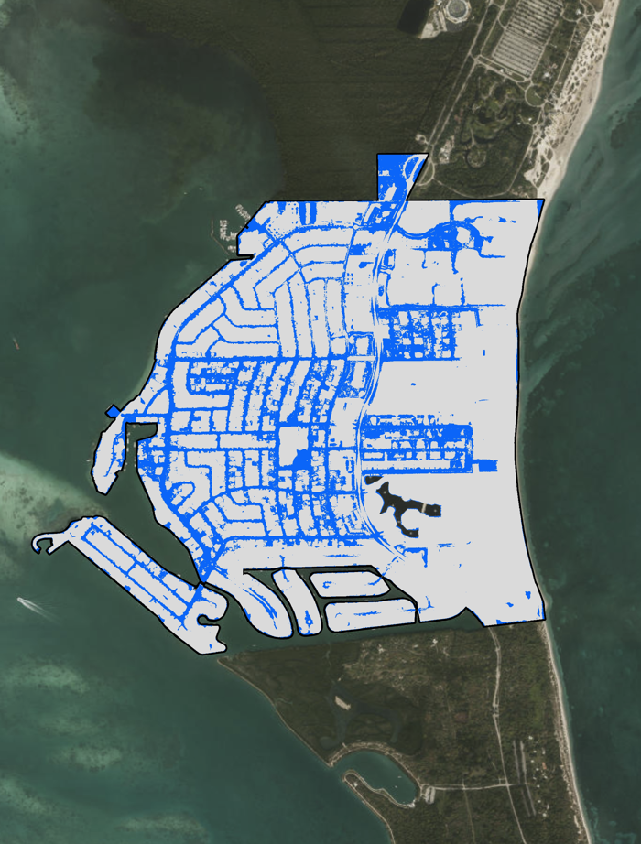
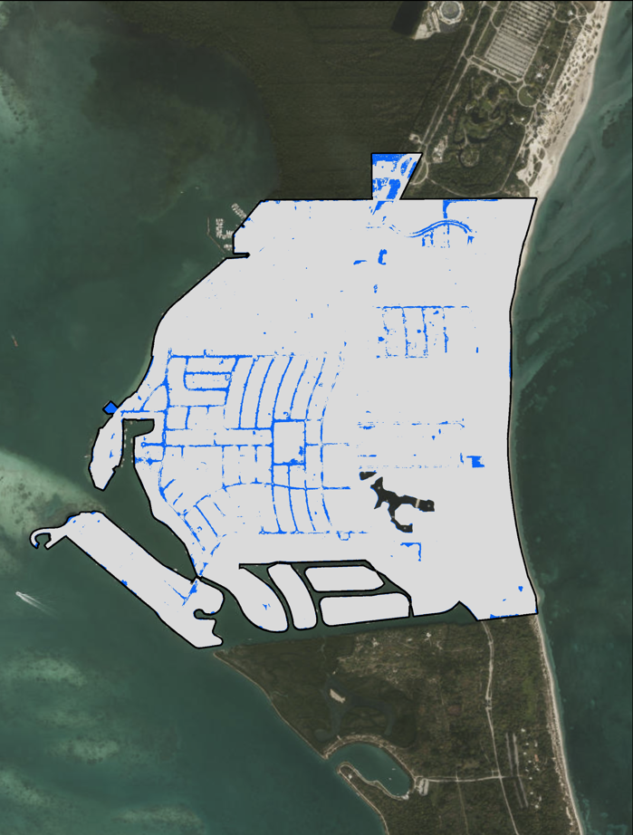
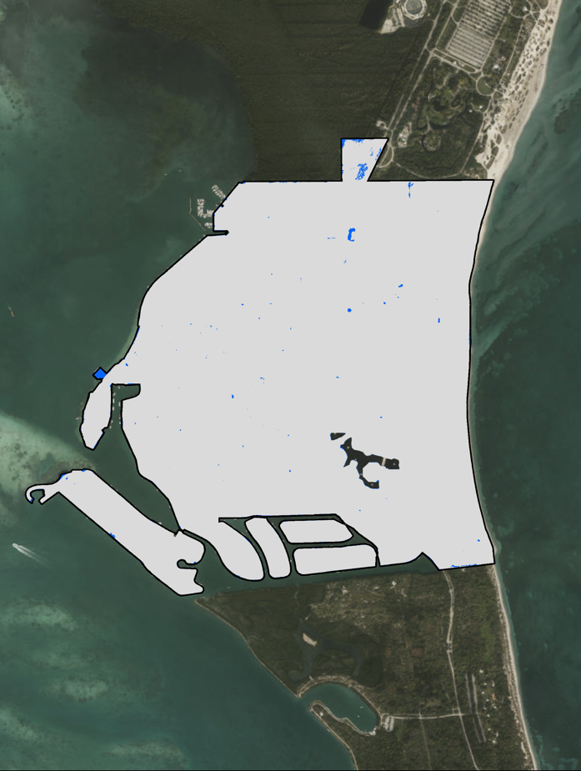
2045: No Adaption
2045: +1 Foot (vulnerable property)
Road Flooding 2045: +2 foot elevation
Road Flooding 2045: No Adaption
2045: +2 Foot (vulnerable property)

Slide 21
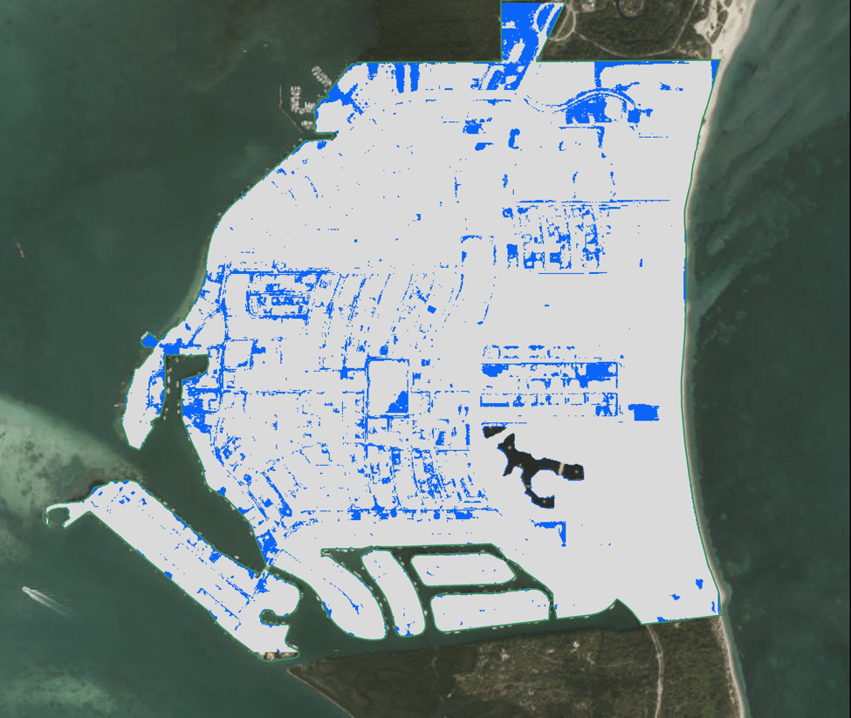
2045 No Adaptation
2045: Seawalls/storm drains + 1 foot road elevation
CRC tools enable customized adaptation scenarios for local governments and property owners

Slide 22
SUCCESFUL CLIMATE ADAPTATION IS “U” SHAPED
City/Government
Community
Large scale climate adaptation infrastructure designed and built by city/govt
Private climate adaptation actions taken by homeowners, businesses, neighborhoods
Coastal Risk’s Climate
Adaptation Technology
www.floodscores.com
“Top Down”
“Bottom Up”
Public engagement by citizens with actionable data and analysis concerning their properties and their neighborhoods
“Side to Side”
Adapted from work
by Peter Williams, IBM
Crowd-sourced and other self-help information between individuals, neighborhoods, etc.

Slide 23
Final Remarks
Adaptation is dynamic. Requires participation and coordination of county, municipal, and private stakeholders.
No single solution.
Infrastructure improvements are interconnected and need to be considered within a holistic framework that considers integrated effects.
Cost effective tools are available to facilitate planning and cost/benefits analysis of specific adaptation scenarios.

